Slide 1
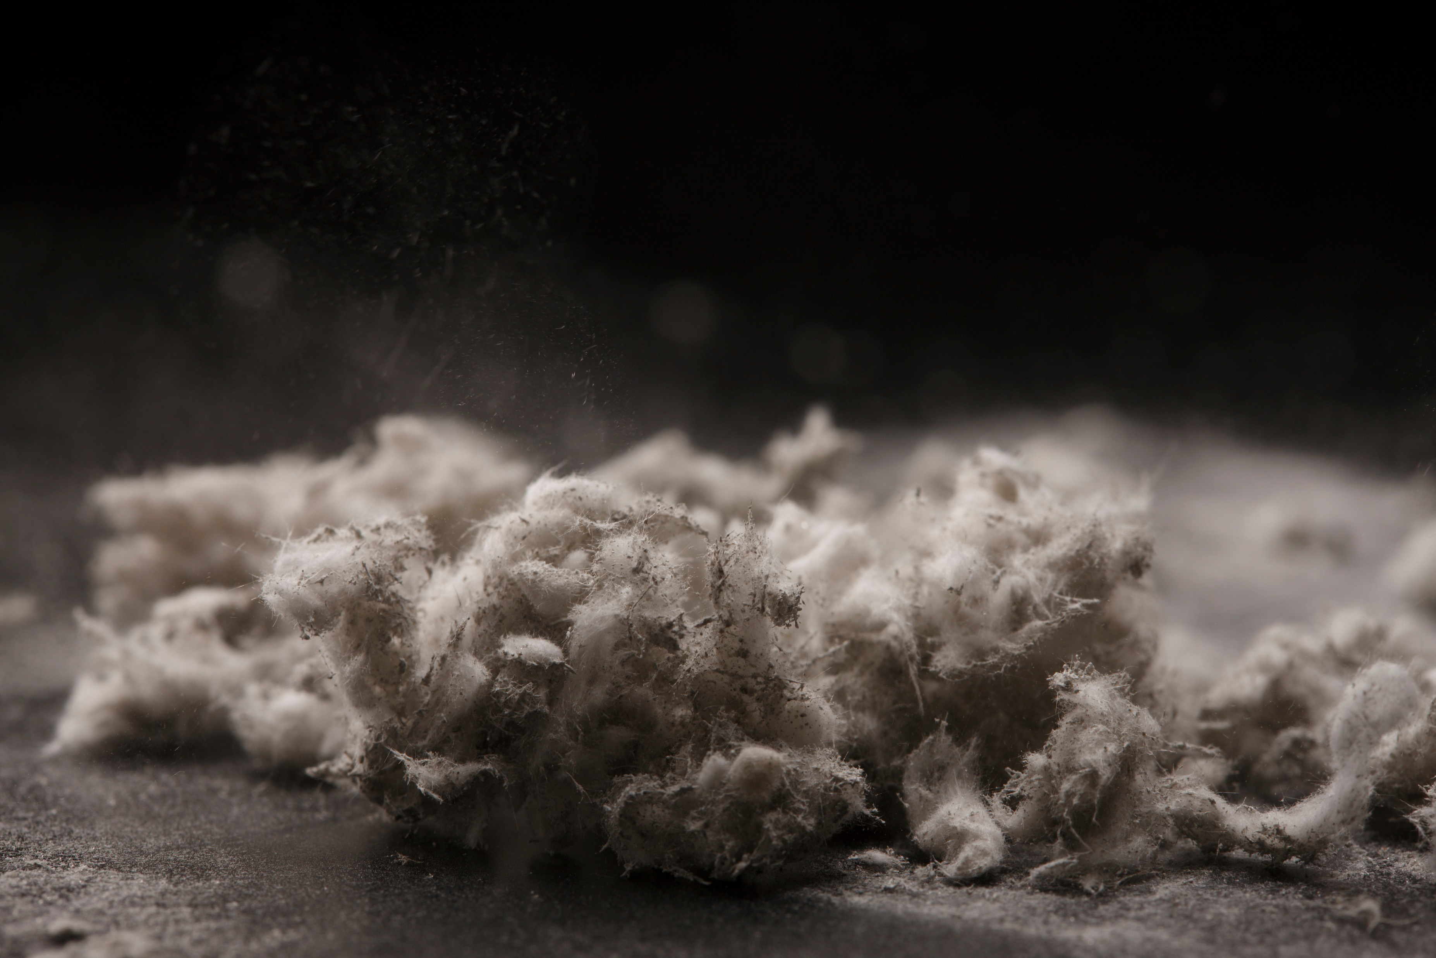
ASBESTOS
Jordan Crane
03/12/2024

Slide 2
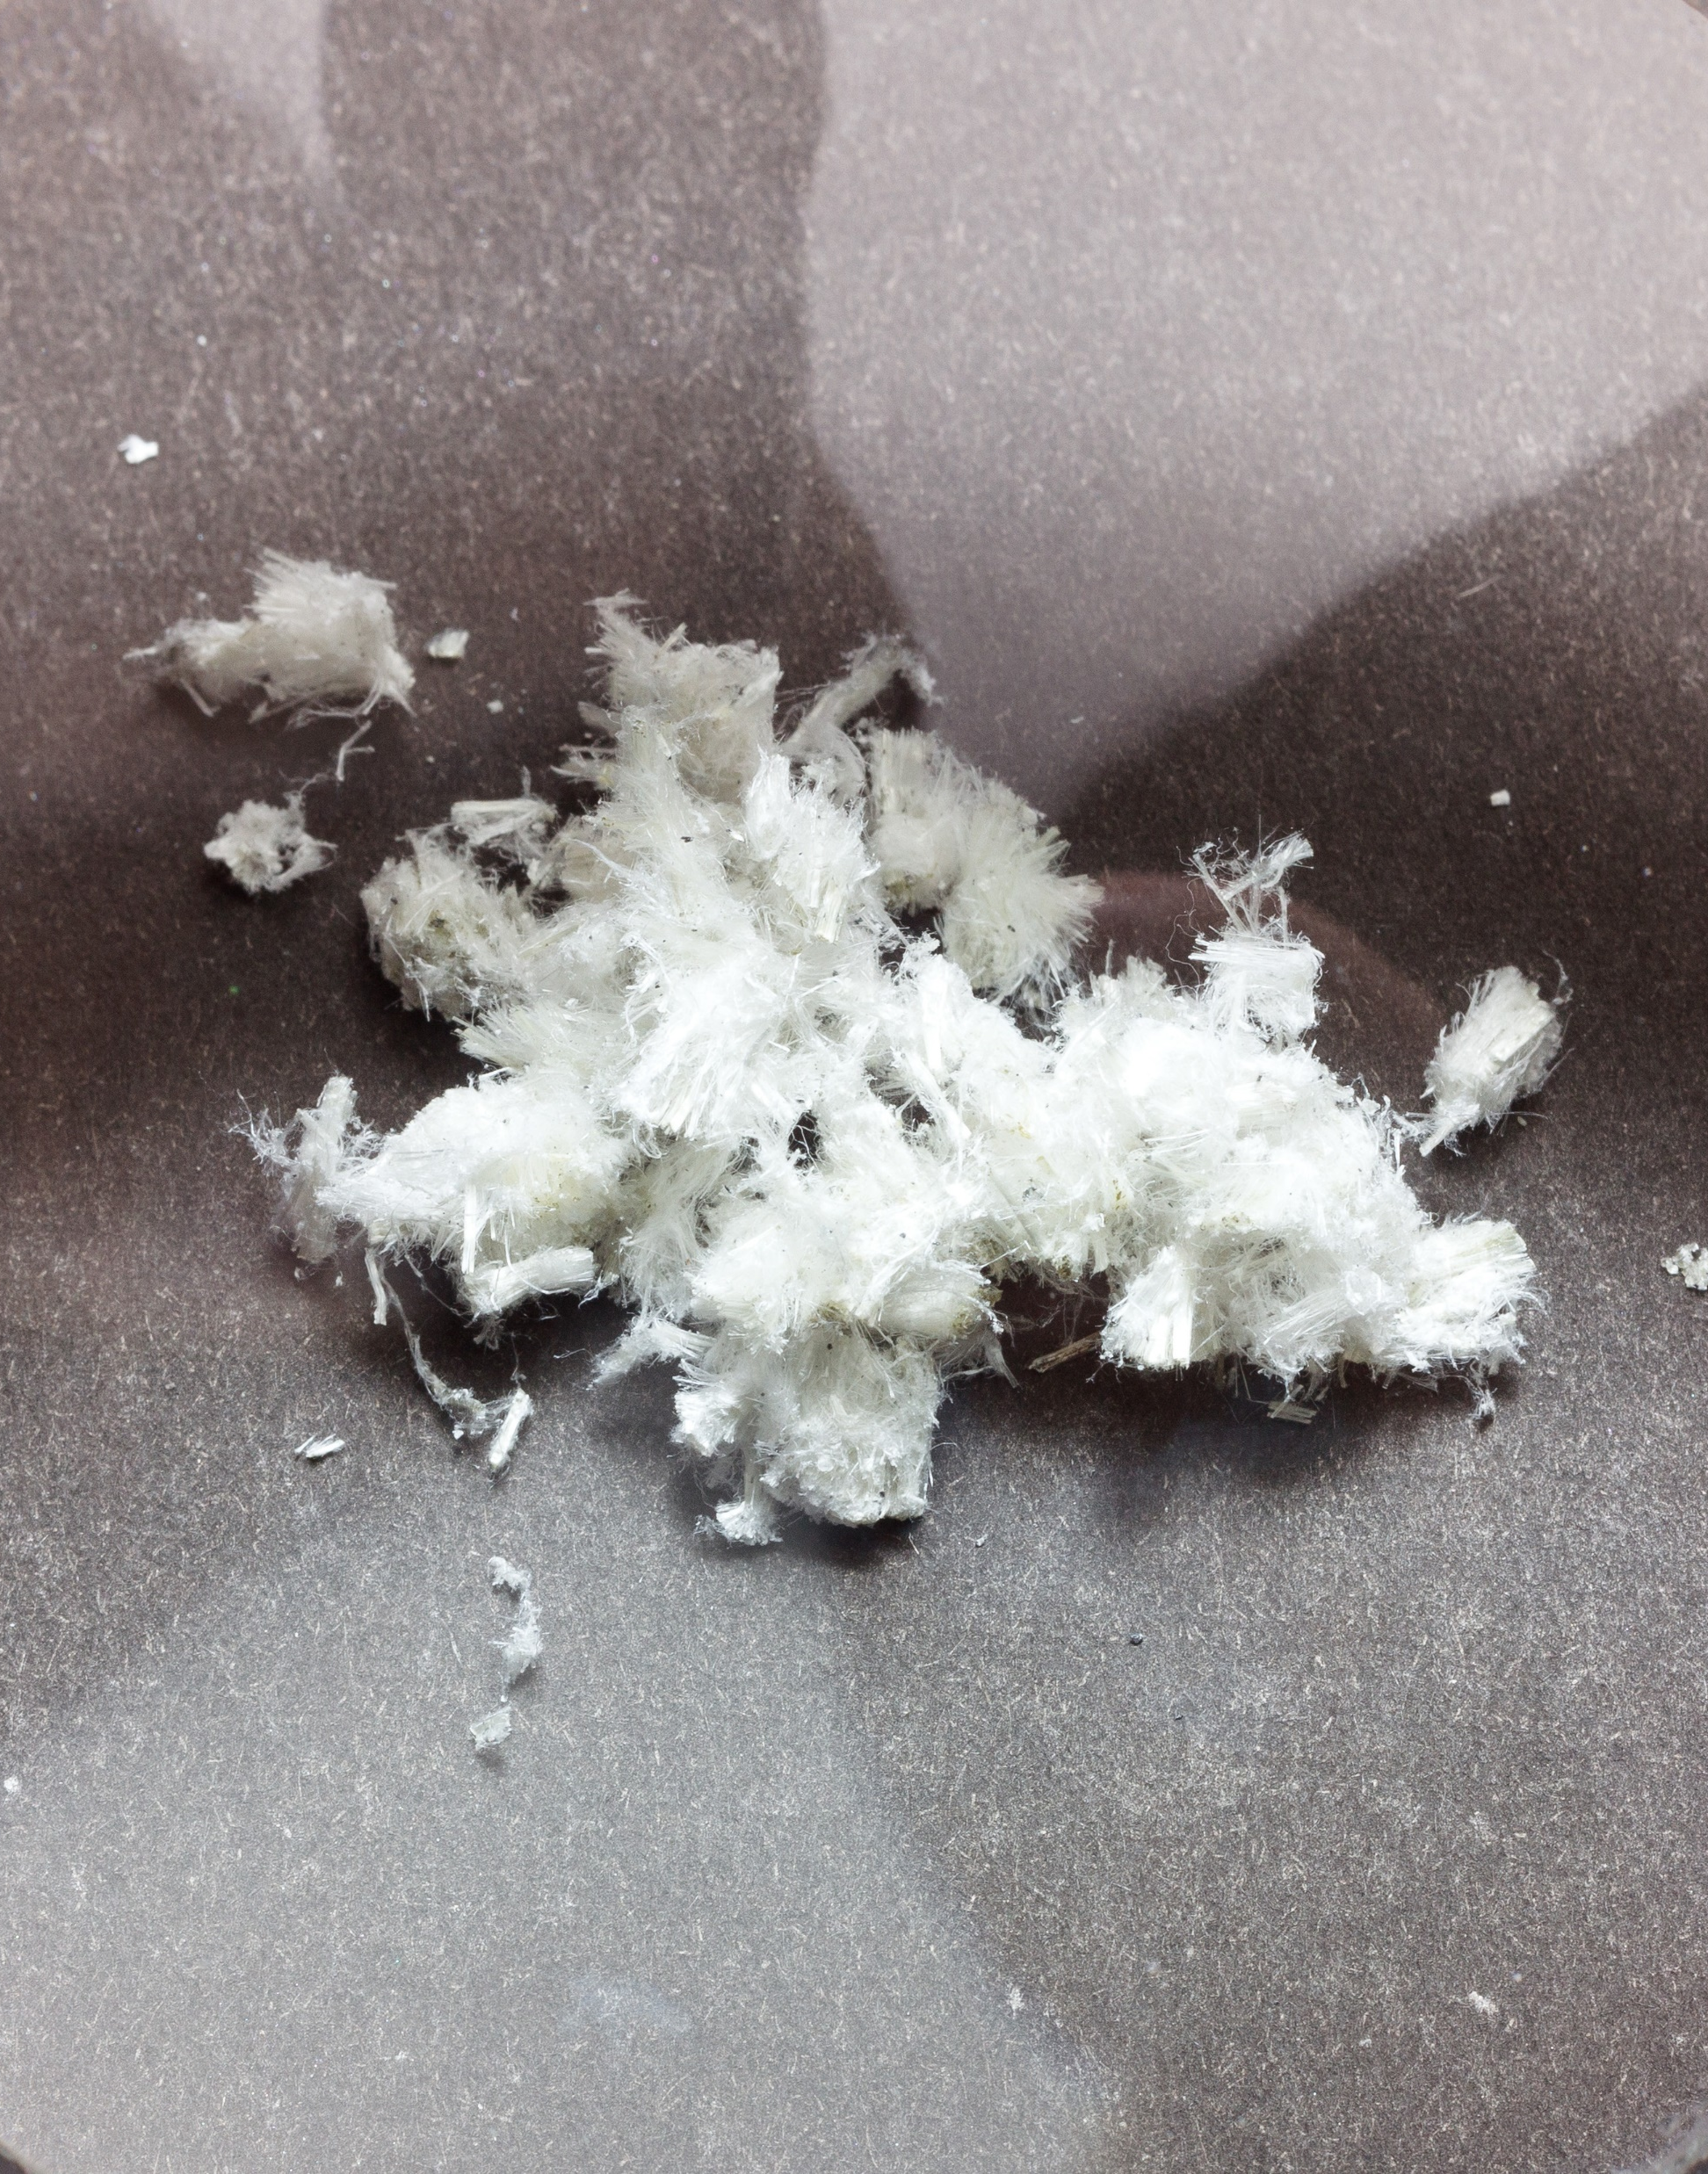
What is Asbestos?
Naturally occurring material found in rock and soil
Fibrous
Durable
Heat resistant
Used in:
Roofing Shingles
Tiles Paper Product
Cement Products
2

Slide 3
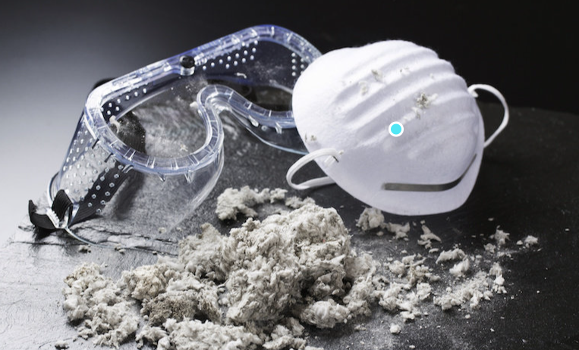
Harm of Asbestos
Can cause injury to lungs
(asbestosis, lung cancer, mesothelioma)
Harmful when inhaled over an extended period of time
Impacts to those working in asbestos mining/milling or industries installing asbestos products
Pose little health risk if structure (pipe) is in stable condition
3

Slide 4
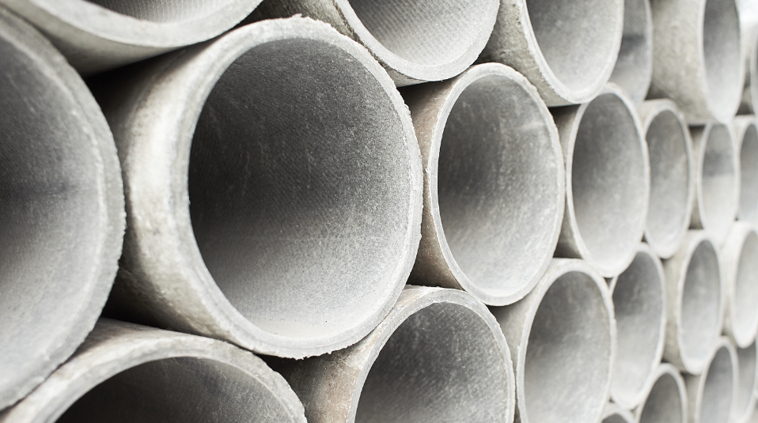
Asbestos in Waterlines
Asbestos in concrete pipes (a.k.a. AC or transite pipe)
Used as reinforcing fiber
Used throughout the world,
Valued for reinforcing due to its strength and durability
Used from 1930s - 1970s
4
Notes:
https://www.mesotheliomahub.com/blog/americas-asbestos-piping/#:~:text=Asbestos%2Dcement%20pipes%20(AC),water%20distribution%20pipes%20are%20transite.
18%
https://www.safewater.org/fact-sheets-1/2017/1/18/asbestos-in-water-and-asbestos-cement-water-pipes
18%
https://www.epa.gov/asbestos/epa-actions-protect-public-exposure-asbestos#:~:text=In%201975%2C%20EPA%20banned%20installation,applied%20and%20friable%20after%20drying.
1975 AC pipe was banded
https://www.lanierlawfirm.com/mesothelioma/asbestos-exposure/products/pipes/#:~:text=Asbestos%20is%20a%20toxic%20substance,risk%20occupations%20for%20developing%20mesothelioma.
1930s-1970s
https://esemag.com/infrastructure/monitor-condition-aging-asbestos-cement-watermains/#:~:text=However%2C%20due%20to%20health%20concerns,was%20stopped%20in%20the%201980s.
Stopped using in the 80s
https://www.epa.gov/asbestos/epa-actions-protect-public-exposure-asbestos#:~:text=1989%20Partial%20Ban%20on%20the%20manufacture%2C%20import%2C%20processing%2C,after%20August%2025%2C%201989.%20These%20uses%20remain%20banned.

Slide 5
Asbestos in Waterlines
Transite pipe is assumed to have a lifespan of 50-70 years
The use of transite pipe stopped in the 1980s
Transite pipe is nearing the end of its useful life
Transite pipe makes up about 18% of waterlines in the United States
5
Notes:
https://www.mesotheliomahub.com/blog/americas-asbestos-piping/#:~:text=Asbestos%2Dcement%20pipes%20(AC),water%20distribution%20pipes%20are%20transite.
18%
https://www.safewater.org/fact-sheets-1/2017/1/18/asbestos-in-water-and-asbestos-cement-water-pipes
18%
https://www.epa.gov/asbestos/epa-actions-protect-public-exposure-asbestos#:~:text=In%201975%2C%20EPA%20banned%20installation,applied%20and%20friable%20after%20drying.
1975 AC pipe was banded
https://www.lanierlawfirm.com/mesothelioma/asbestos-exposure/products/pipes/#:~:text=Asbestos%20is%20a%20toxic%20substance,risk%20occupations%20for%20developing%20mesothelioma.
1930s-1970s
https://esemag.com/infrastructure/monitor-condition-aging-asbestos-cement-watermains/#:~:text=However%2C%20due%20to%20health%20concerns,was%20stopped%20in%20the%201980s.
Stopped using in the 80s
https://www.epa.gov/asbestos/epa-actions-protect-public-exposure-asbestos#:~:text=1989%20Partial%20Ban%20on%20the%20manufacture%2C%20import%2C%20processing%2C,after%20August%2025%2C%201989.%20These%20uses%20remain%20banned.

Slide 6
Where can asbestos waterlines present a risk to human health?
PIPE CORROSION RELEASES ASBESTOS WHICH CAN EXPOSE USERS.
Working/performing maintenance on transite waterlines (cutting and tapping activities)
SOME WAYS USERS CAN BE EXPOSED INCLUDE:
WASHING LAUNDRY
HOT SHOWERS
WASHING DISHES
6

Slide 7
Mountain Home Water Quality
DEQ requires sampling for asbestos in the distribution system
Sample every 9 years
DEQ has never seen an asbestos problem in the Boise Region (including Elmore County)
If there were a problem, DEQ would put the City on a quarterly sampling monitoring plan
If the quarterly sampling showed an issue, DEQ would work with the system to address asbestos
The City is not on a quarterly sampling requirement, nor has received any compliance letters from DEQ to address transite pipe in the distribution system.
7

Slide 8
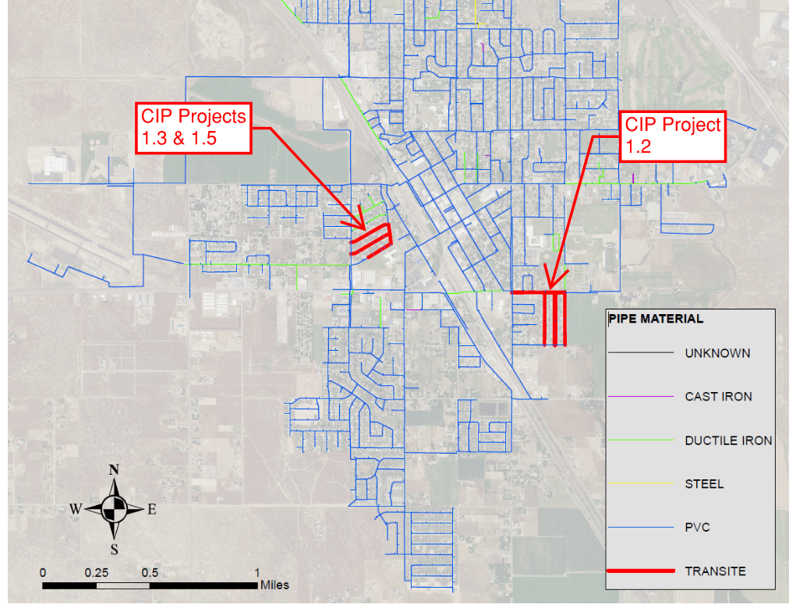
Mountain Home Asbestos Pipe
8,400 feet of 6” transite pipe
1.8% of total distribution pipe
Collaboration across multiple disciplines and offices
The locations with transite pipes were identified in the Water Master Plan for replacement as Priority 1 projects due to the age and difficulty in maintaining
8

Slide 9
Status of CIP Projects to Replace Transite Pipe
CIP Project 1.2 – Project has been designed. Waiting for budget to bid and construct
CIP Project 1.3 & 1.5 – Currently being designed. Scheduled to bid during winter 2024-2025.
9

